Slide 1
CSC 439 Sprint Week 2
Jacob Moore, Zack Sprague, Craig James, Chris Wells, Joshua McGuire, Reed Inderwiesche

Slide 2
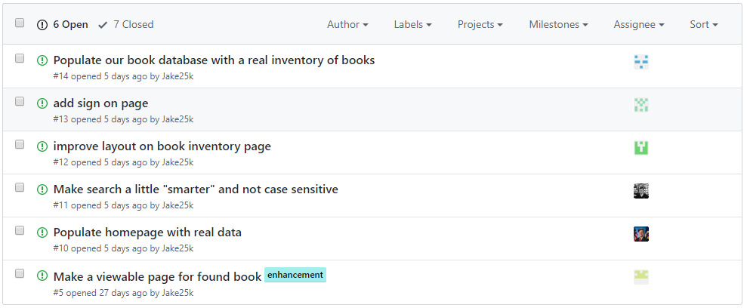
Issues from this week

Slide 3
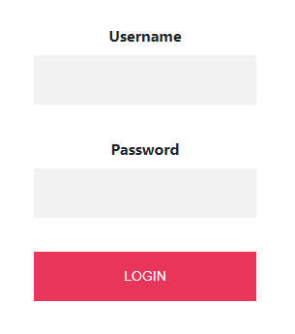

Team Lead/Developer: Zack Sprague
Task: 1. Set up users in the database
2. Added login button to all the html pages on the nav bar
3. Implemented the login form for users to create
accounts if not already signed up

Slide 4
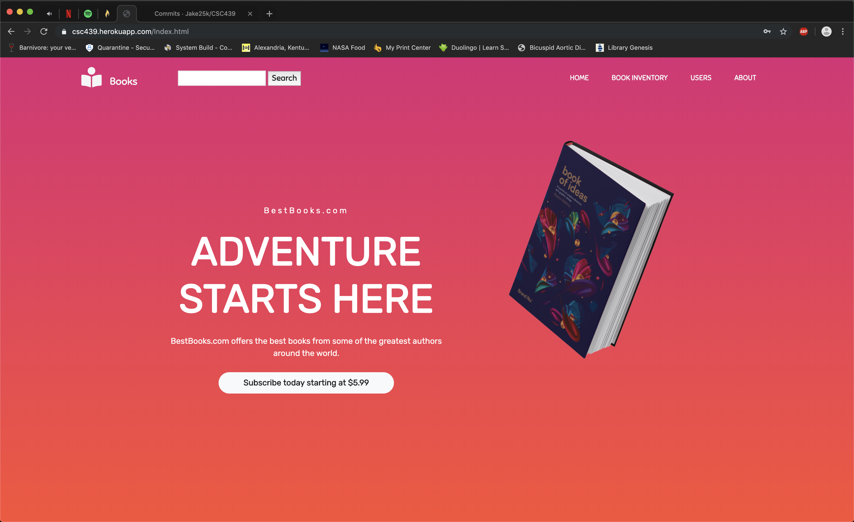

Tester/Developer: Jacob Moore
1. Added information to the homepage

Slide 5
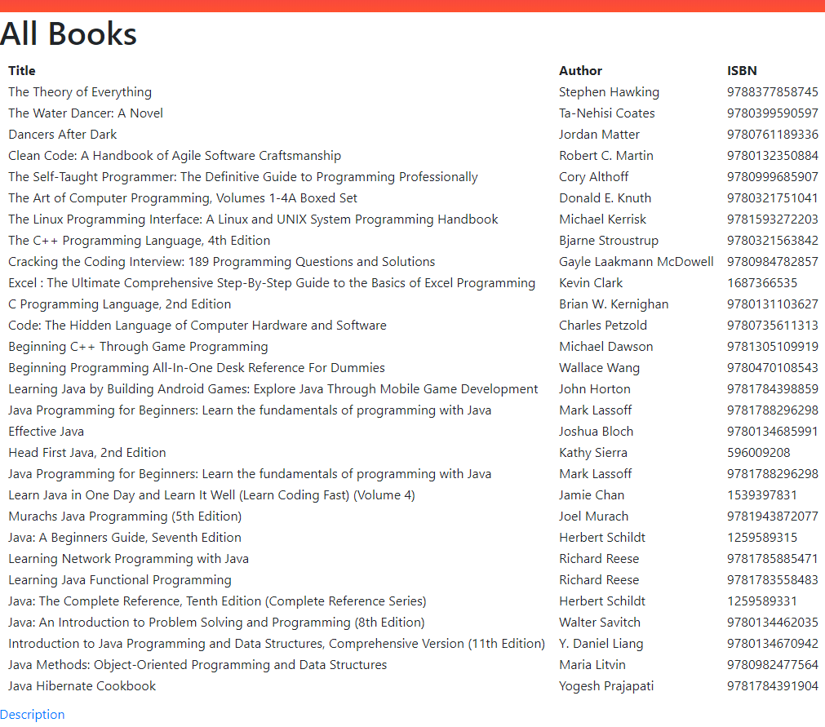
Tester/Developer: James Craig
Tasks:
1. Improved layout on book inventory page

Slide 6
SCM Manager/Developer: Reed Inderwiesche
Tasks:
Updated the books table in the database.

Slide 7
Build Manager/Developer: Chris Wells
Task:
1. Make the search bar “smarter” and not case-sensitive

Slide 8
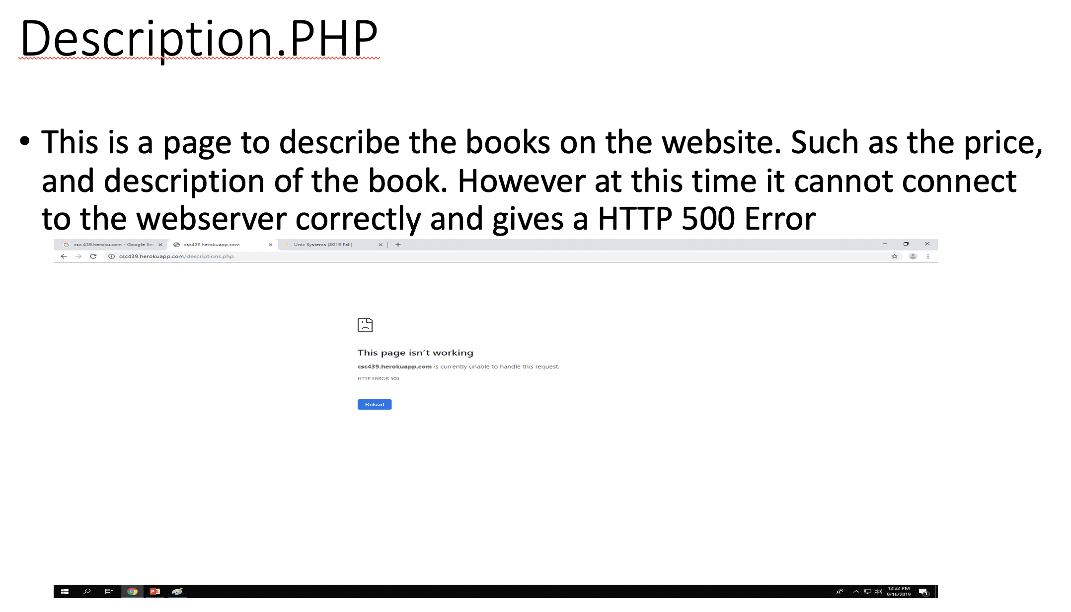
Tester/Developer: Josh McGuire

